Slide 1
Generative Modeling by Estimating Gradients of the Data Distribution
NIPS 2019
Yang Song, Stefano Ermon
Presented by Beomsoon Park
C&I LAB

Slide 2
Contents
Introduction
Score-based Generative Model
Challenges of Score-based Generative Modeling
Noise Conditional Score Networks (NCSN)
Experiments
C&I LAB

Slide 3
Introduction
C&I LAB

Slide 4
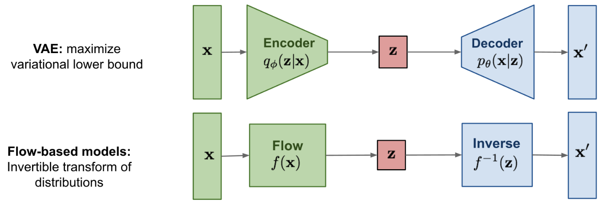
Introduction
Limitation of likelihood-based model
Training Objective : Log-likelihood
High Computational Cost
& Surrogate Loss
Specialized Structure is required
https://lilianweng.github.io/posts/2021-07-11-diffusion-models/
C&I LAB

Slide 5
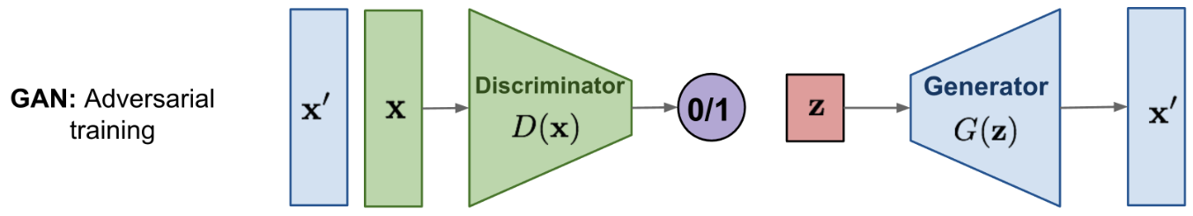
Introduction
Limitation of GAN
Training Objective : Minimizing divergence
Unstable Learning
Inappropriate objective
to be compared with other models
https://lilianweng.github.io/posts/2021-07-11-diffusion-models/
C&I LAB

Slide 6
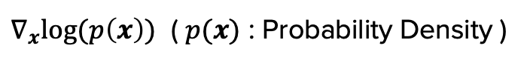
Introduction
Score-based generative model
Generative Model based on estimating and sampling from the “score” of the distribution
Score
$∇_{x}log⁡(p\left(x\right))$ ( $p(x)$ : Probability Density )
The gradient of log-density function
C&I LAB

Slide 7
Introduction
Score-based generative model
[Training]
Objective
Score Matching
: Training neural network to match the scores of data distribution
[Inference]
Annealed Langevin Dynamics
: Random initial sample → High density regions (with scores)
C&I LAB

Slide 8
Score-based Generative Model
C&I LAB

Slide 9
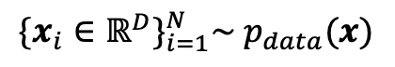
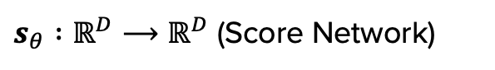
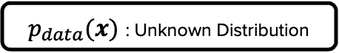

Score-based Generative Model
Score Network
$${\{x_{i}∈ℝ^{D}\}}_{i=1}^{N}\sim p_{data}(x)$$
$$\text{Each} x_{i} \text{with} D \text{features}\text{: }\text{i}\text{.}\text{i}\text{.}\text{d}$$
$p_{data}(x)$ : Unknown Distribution
$s_{θ} :ℝ^{D}{⟶ℝ}^{D}$ (Score Network)
Learn the model by estimating $∇_{x}log{(p}_{data}(x))$ & Generate new samples from estimated data distribution
C&I LAB

Slide 10
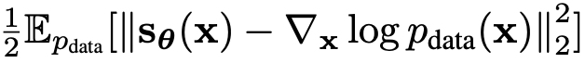
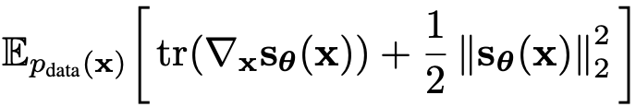
Score-based Generative Model
Score Matching for Score Estimation
Main Objective
Intractable
Original Score Matching
High Computational Cost
→ Not scalable (Not applicable to high-dimensional data)
C&I LAB

Slide 11
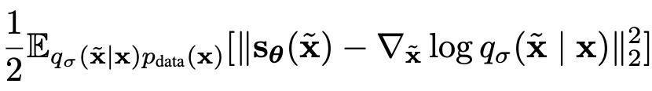
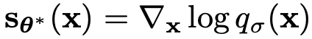
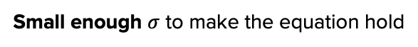
Score-based Generative Model
Score Matching for Score Estimation
Score Matching Techniques to cover scalability
Denoising Score Matching
Constraint
Optimal Score Network
Small enough $σ$ to make the equation hold
C&I LAB

Slide 12
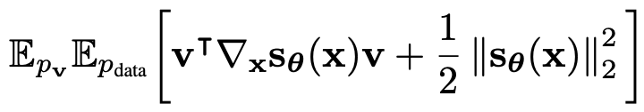
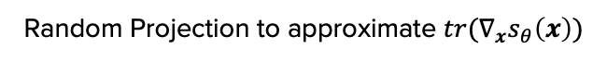
Score-based Generative Model
Score Matching for Score Estimation
Score Matching Techniques to cover scalability
Sliced Score Matching
Random Projection to approximate $tr(∇_{x}s_{θ}\left(x\right))$
Efficient Computation
with forward mode auto-differentiation
More computation time is required
Constraint
Available on unperturbed distribution
C&I LAB

Slide 13
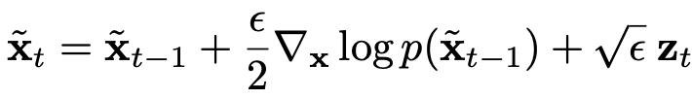
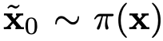
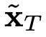
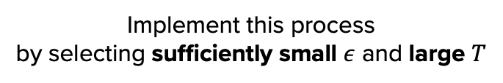
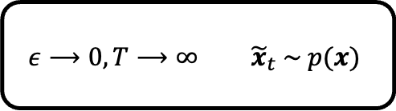
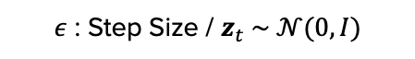
Introduction
Sampling with Langevin Dynamics
T steps of Sampling Process
$ε$ : Step Size / $z_{t} \sim 𝒩(0, I)$
$$ε⟶0, T⟶∞{ \tilde{x}}_{t} \sim p(x)$$
Implement this process
by selecting sufficiently small $ε$ and large $T$
C&I LAB

Slide 14
Challenges of Score-based Generative Modeling
C&I LAB

Slide 15
Challenges of Score-based Generative Modeling
Manifold Hypothesis
“Data in the real world tend to concentrate
on low dimensional manifolds embedded in a high dimensional space”
C&I LAB

Slide 16
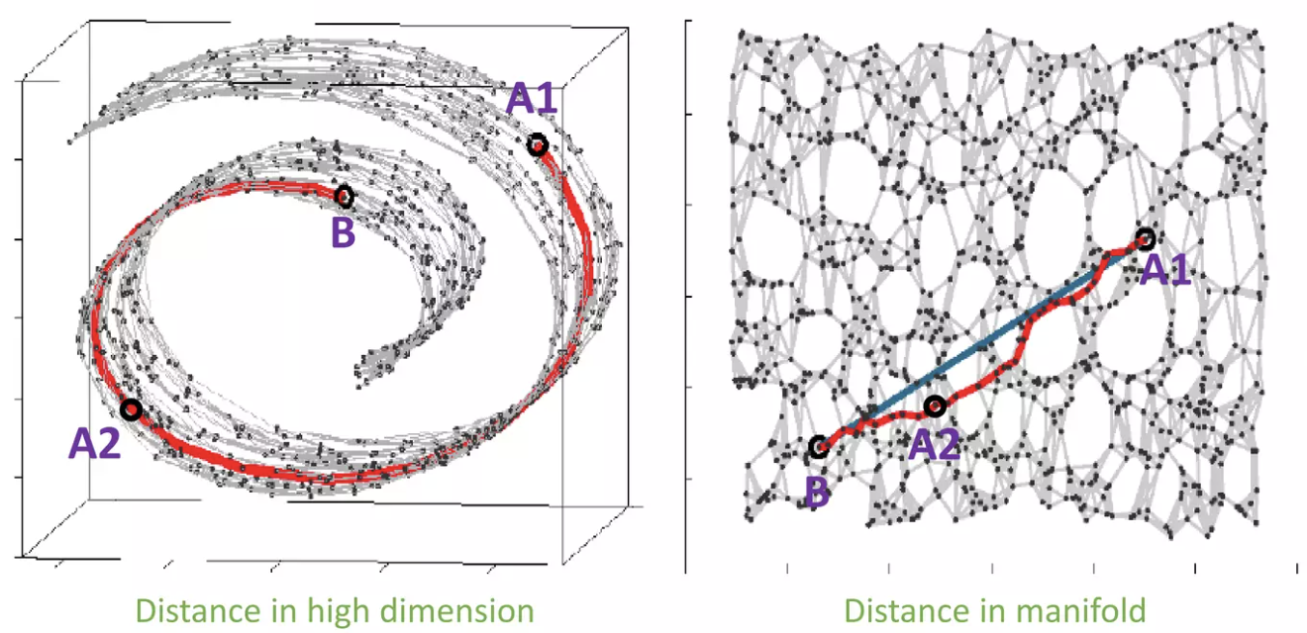
Challenges of Score-based Generative Modeling
Manifold
https://www.slideshare.net/NaverEngineering/ss-96581209
C&I LAB

Slide 17
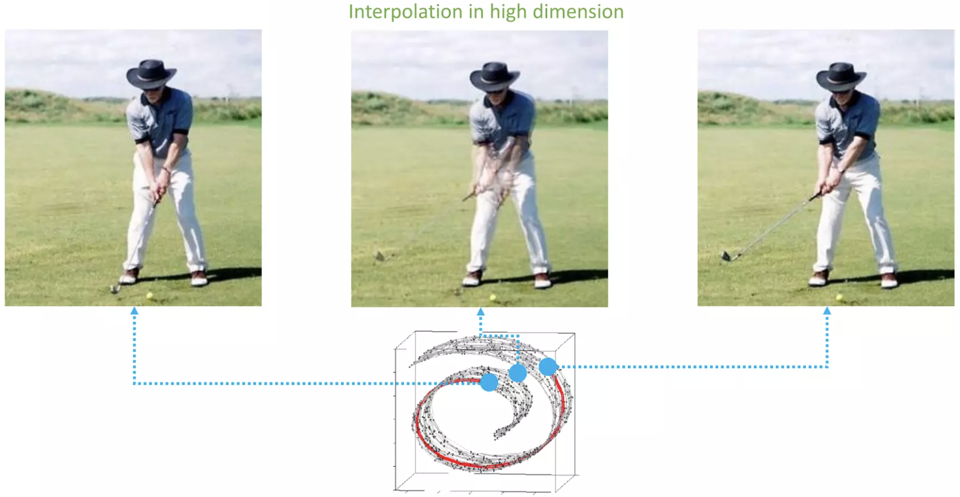
Challenges of Score-based Generative Modeling
Manifold
https://www.slideshare.net/NaverEngineering/ss-96581209
C&I LAB

Slide 18
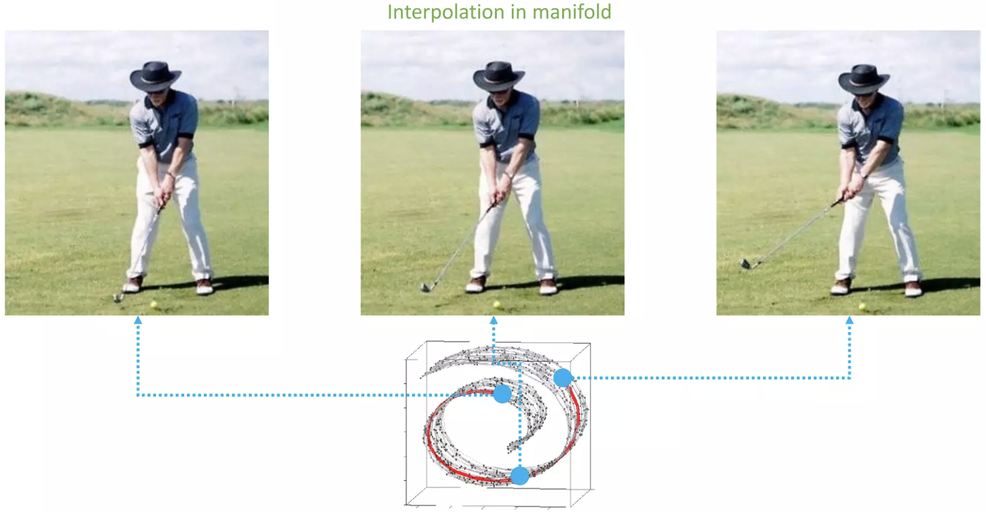
Challenges of Score-based Generative Modeling
Manifold
https://www.slideshare.net/NaverEngineering/ss-96581209
C&I LAB

Slide 19
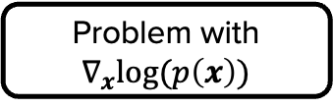
Challenges of Score-based Generative Modeling
Manifold Hypothesis
Sampling process may not follow the desired way
Problem with $∇_{x}log⁡(p\left(x\right))$
Scores are estimated in the “ambient” space
C&I LAB

Slide 20
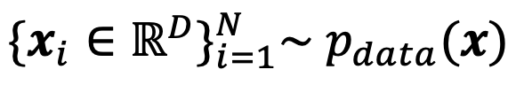
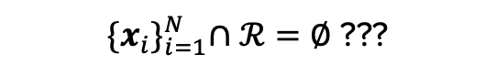
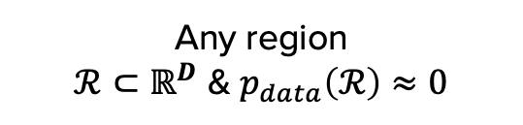
Challenges of Score-based Generative Modeling
Low data density region
Any region
$ℛ⊂ℝ^{D}$ & $p_{data}\left(ℛ\right)≈0$
What if…
${\{x_{i}\}}_{i=1}^{N}∩ℛ=∅$ ???
Lacking data to estimate the score of data distribution
and that region with these samples
C&I LAB

Slide 21
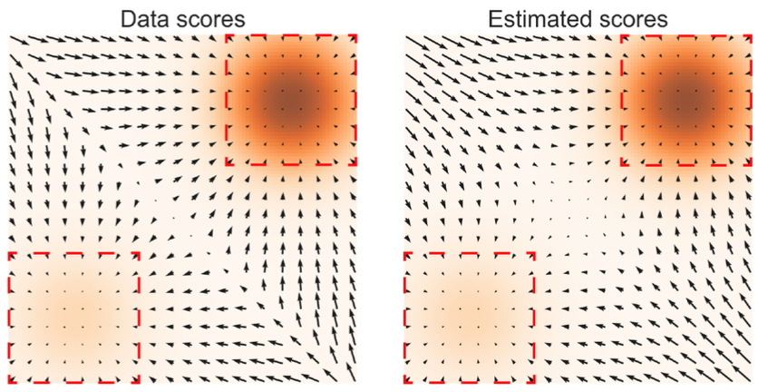
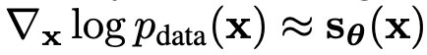
Challenges of Score-based Generative Modeling
Low data density region
Relatively denser region
Region with low data density
C&I LAB

Slide 22
Challenges of Score-based Generative Modeling
Low data density region
Inaccurate
Estimation
C&I LAB

Slide 23
Challenges of Score-based Generative Modeling
Slow mixing of Langevin Dynamics
Real Data
→ Usually multi-modal distribution
Multiple modes separated
with low data density region
2 modes separated with low data density region
Langevin Dynamics cannot find
relative weights of these modes
Not converging to the true distribution
Very small step size & Many steps are required
Not achievable in reasonable time
C&I LAB

Slide 24
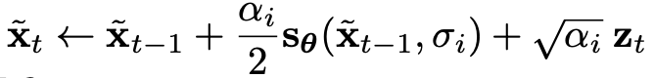
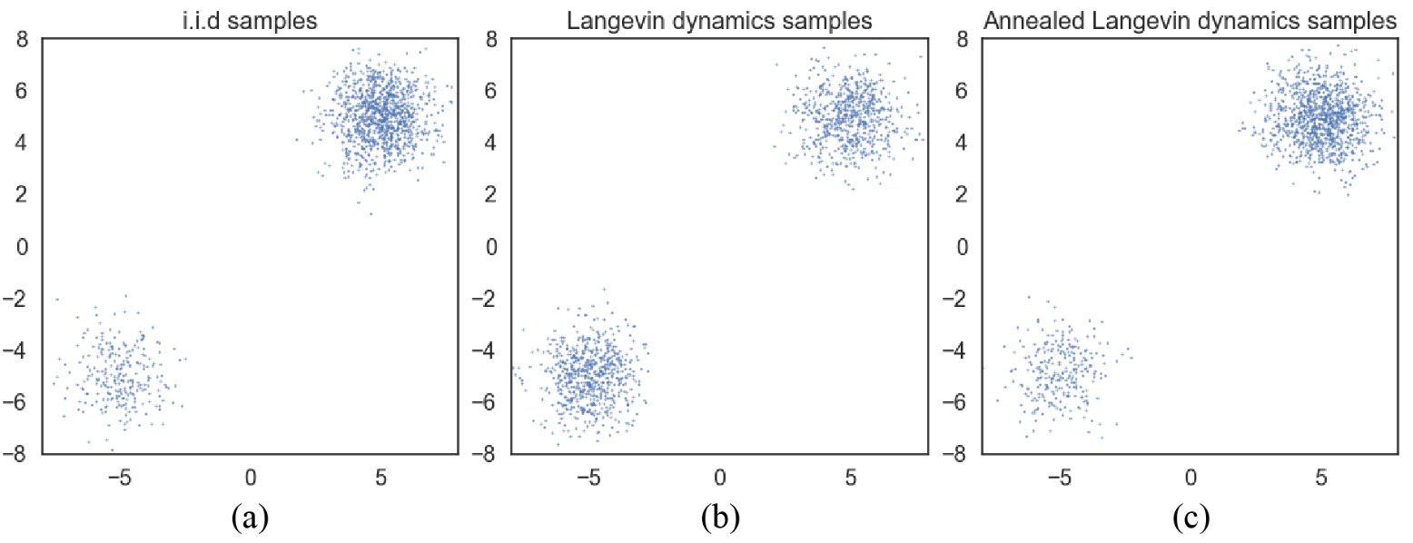
Challenges of Score-based Generative Modeling
Slow mixing of Langevin Dynamics
Sampling with ground truth scores
Incorrect relative weight estimation
C&I LAB

Slide 25
Noise Conditional Score Networks (NCSN)
C&I LAB

Slide 26
Noise Conditional Score Networks (NCSN)
Primary Idea for NCSN
1
Perturb the data using various levels of (random Gaussian) noise
Random Gaussian noise
Cover the whole ambient space
Perturbed data
→ Not Confined to the manifold
Scores are well-defined
→ Improve score estimation
C&I LAB

Slide 27
Noise Conditional Score Networks (NCSN)
Primary Idea for NCSN
2
Simultaneously estimating scores corresponding to
all noise by training a single conditional noise network
Initial steps – Large Noise
Subsequently low noise
Anneal down the noise level
Obtain all benefits from each noise level
C&I LAB

Slide 28
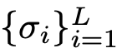
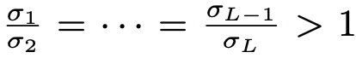
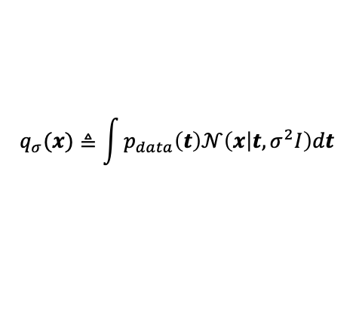
Noise Conditional Score Networks (NCSN)
Noise Conditional Score Networks
Noise
: Positive geometric sequence
Perturbation
$$q_{σ}(x)≜\int{p_{data}\left(t\right)𝒩\left(x | t,σ^{2}I\right)dt}$$
Noise Conditional Score Network
C&I LAB

Slide 29
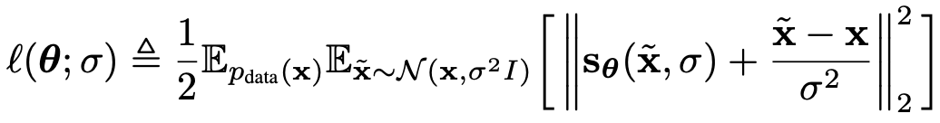
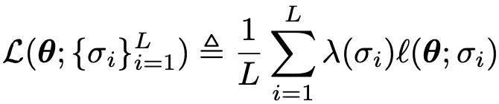
Noise Conditional Score Networks (NCSN)
Learning NCSNs via score matching
“Denoising score matching” objective
C&I LAB

Slide 30
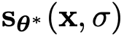
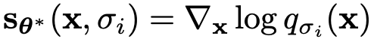
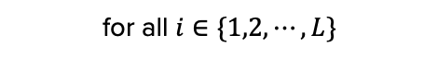
Noise Conditional Score Networks (NCSN)
Learning NCSNs via score matching
: Optimal score network
for all $i∈\{1,2,⋯,L\}$
C&I LAB

Slide 31
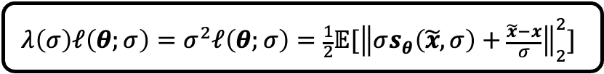
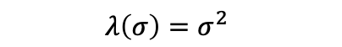
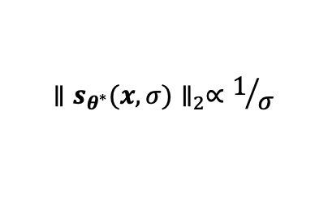
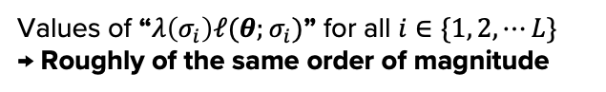
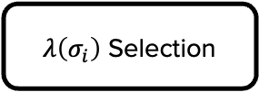
Noise Conditional Score Networks (NCSN)
Learning NCSNs via score matching
$λ\left(σ_{i}\right)$ Selection
Ideal Case
Values of “$λ\left(σ_{i}\right)ℓ(θ;σ_{i})$” for all $i∈\{1, 2, ⋯L\}$
→ Roughly of the same order of magnitude
$${∥s_{θ^{∗}}(x,σ)∥}_{2}∝1/σ$$
$$λ\left(σ\right)=σ^{2}$$
$$λ\left(σ\right)ℓ\left(θ;σ\right)=σ^{2}ℓ\left(θ;σ\right)=\frac{1}{2}𝔼[{\left\|σs_{θ}\left(\tilde{x},σ\right)+\frac{\tilde{x}−x}{σ}\right\|}_{2}^{2}]$$
C&I LAB

Slide 32
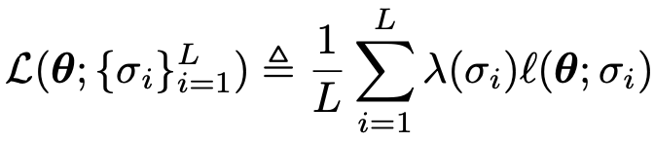
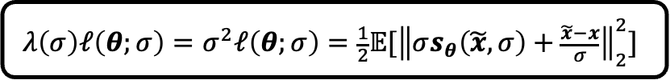
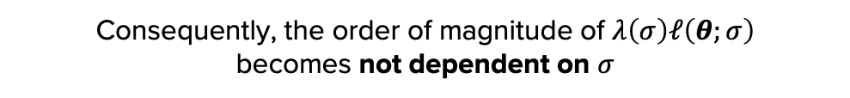
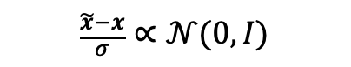
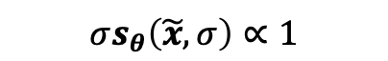
Noise Conditional Score Networks (NCSN)
Learning NCSNs via score matching
$$λ\left(σ\right)ℓ\left(θ;σ\right)=σ^{2}ℓ\left(θ;σ\right)=\frac{1}{2}𝔼[{\left\|σs_{θ}\left(\tilde{x},σ\right)+\frac{\tilde{x}−x}{σ}\right\|}_{2}^{2}]$$
$$σs_{θ}\left(\tilde{x},σ\right)∝1$$
$$\frac{\tilde{x}−x}{σ}∝𝒩(0,I)$$
Consequently, the order of magnitude of $λ\left(σ\right)ℓ\left(θ;σ\right)$
becomes not dependent on $σ$
Tractable & Quantitative comparison is possible
C&I LAB

Slide 33
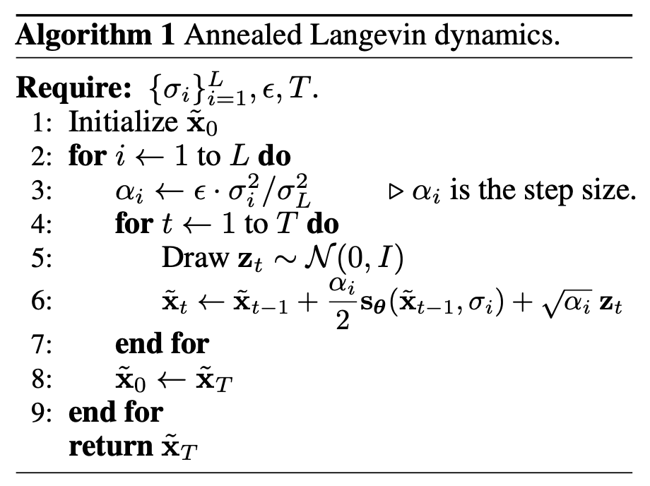
Noise Conditional Score Networks (NCSN)
NCSN inference via annealed Langevin Dynamics
Initialize samples from some fixed prior distribution
Uniform Noise
C&I LAB

Slide 34
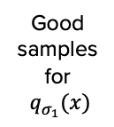

Noise Conditional Score Networks (NCSN)
NCSN inference via annealed Langevin Dynamics
Initial Steps
Less low
density regions
Good
samples
for
$q_{σ_{1}}(x)$
Large
$$σ$$
More accurate
score estimation
Faster mixing of
Langevin Dynamics
C&I LAB

Slide 35
Noise Conditional Score Networks (NCSN)
NCSN inference via annealed Langevin Dynamics
Sampling Process
During Sampling Process,
Score Estimation & Langevin Dynamics
enhances in high density regions
${\tilde{x}}_{t}$ from $q_{σ_{L}}(x)$ results in samples with good quality
C&I LAB

Slide 36





Noise Conditional Score Networks (NCSN)
NCSN inference via annealed Langevin Dynamics
Motivated from
fixing the magnitude of SNR “$\frac{α_{i}s_{θ}(x,σ_{i})}{2\sqrt{α_{i}}z}$”
How to Down-tuning $α_{i}$
$$α_{i}∝σ_{i}^{2}$$
$$∝\frac{1}{4}$$
C&I LAB

Slide 37
Experiments
C&I LAB

Slide 38
Experiments
Efficacy of annealed Langevin dynamics
$$L=10, σ_{1}=10,σ_{10}=0.1$$
C&I LAB

Slide 39

Experiments
Intermediate Samples
C&I LAB

Slide 40

Experiments
Setup for experiments on MNIST, CelebA, CIFAR-10
(For CelebA) Center-crop to 140 X 140 → Resize images into 32 X 32
Rescale all images to make pixel values within $\left[0,1\right]$
$L=10, σ_{1}=1,σ_{10}=0.01$ (${\{σ_{i}\}}_{i=1}^{L}$ : Geometric Sequence)
$T=100, ε=2×{10}^{−5}$ for annealed Langevin dynamics
${\tilde{x}}_{0}\sim π(x)$ → Uniform Noise
C&I LAB

Slide 41

Experiments
Uncurated Samples from annealed Langevin dynamics
C&I LAB

Slide 42

Experiments
IS & FID Scores
C&I LAB

Slide 43

Experiments
Inpainting Experiments
C&I LAB

Slide 44

Experiments
Inpainting Experiments
C&I LAB

Slide 45
Thank you
C&I LAB

